Slide 1
Computer Vision based Age Classification based on Hand image
Guided by: Prof. Jyoti Madake
Presented by:
36.Akshata Kodak
41.Omkar Kulkarni
49.Prutha Mane

Slide 2
Introduction
Literature Survey
Research Gap
Novelty
Methodology
Results
Conclusion
CONTENTS

Slide 3
Introduction
Age prediction is important for
To enhance the outcomes of criminal investigations
services subject to an age limit
To predict age without identifying the person
Proposed system aims to predict age using Hand Image

Slide 4
Literature Review
Automatic Age Estimation from Face Image
Skin feature extraction and processing model for statistical skin age estimation
Improvement of age estimation using an efficient wrinkles descriptor."
Estimate the age of a person by analysis of wrinkles on face images.
To extract wrinkle information on face image edges are detected using the canny edge detection technique.
Skin feature extraction and processing model for statistical skin age estimation is proposed.
Wrinkle features used include length, width, depth, average cell area and number of cells.
Local Matched Filter Binary Pattern (LMFBP) designed specifically for the detection and extraction of skin wrinkles.
both the Matched Filter and the texture operator Local Binary Pattern (LBP).

Slide 5
Research Gap
1.Complexity
3.Accuracy
High Computational complexity
Low Accuracy
2.Results
4.Estimated using
Disparities in the results
Face Image

Slide 6
Novelty
1.Power
3.Speed
Consumes Less Power
Faster speed
2.Efficiency
4.Accuracy
High Efficiency
High Accuracy

Slide 7
METHODOLOGY
DATA ACQUISITION
IMAGE PREPROCESSING
CLASSIFICATION
FEATURE EXTRACTION

Slide 8
DATA ACQUISITION
Dataset consists of 5689 images.
It is obtained from Kaggle.
Table below shows the distribution of dataset in 3 classes
AGE GROUP | Class | No. of Images
0-25 | Young | 2000
26-55 | Adult | 1866
55+ | Old | 1823

Slide 9
IMAGE PRE-PROCESSING
Input Image
Resizing to 300x300
Converting to Grayscale

Slide 10
Feature Extraction Techniques
GLCM
Gabor
Features extracted are energy, correlation, dissimilarity, contrast, and entropy.
A kernel size of 3x3 is used with sigma=pi/4 and theta=2
LBP
Gabor + LBP
GLCM + Gabor
Parameters used- n points=24 and radius=3
The corresponding parameters of gabor and LBP are used
The corresponding parameters of GLCM and Gabor are used

Slide 11
Comparison of Accuracies Obtained
Classifier | GLCM | Gabor | LBP | Gabor +GLCM | Gabor +LBP
XGBoost | 0.869 | 0.869 | 0.7944 | 0.825 | 0.781
Linear SVM | 0.841 | 0.8669 | 0.7055 | 0.804 | 0.726
KNN | 0.856 | 0.734 | 0.7007 | 0.769 | 0.912
Random forest | 0.805 | 0.93 | 0.809 | 0.74 | 0.945
Decision Tree | 0.658 | 0.808 | 0.7 | 0.725 | 0.635

Slide 12
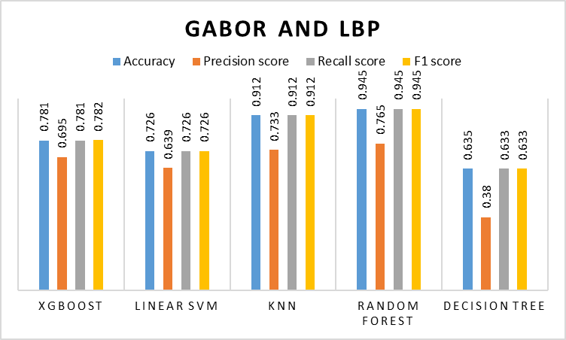
Performance Metrics

Slide 13
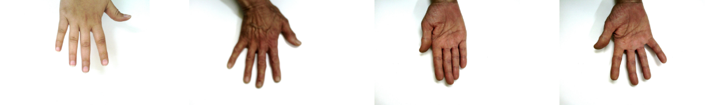
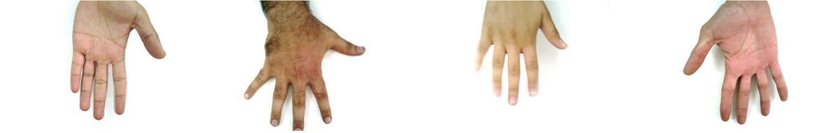
Results
Actual Label: Young
Predicted Label: Young
Actual Label: Old
Predicted Label: Old
Actual Label: Old
Predicted Label: Adult
Actual Label: Old
Predicted Label: Old
Actual Label: Young
Predicted Label: Young
Actual Label: Adult
Predicted Label: Adult
Actual Label: Young
Predicted Label: Young
Actual Label: Adult
Predicted Label: Adult

Slide 14
CONCLUSION
Obtained results with high accuracy
Gabor and LBP-based feature extractor
Accuracy of 94.5%
GLCM-based feature extractor
Accuracy of 86.9%
Significantly reduced feature vector dimensions

Slide 15
References
[1] Shi, Lijian, Chaofang Zhao, Kaiguo Fan, Yingni Shi, and Peng Liu. "Texture feature application in oil spill detection by satellite data." In 2008 Congress on Image and Signal Processing, vol. 4, pp. 784-788. IEEE, 2008.
[2] Pramanik, Anima, Sobhan Sarkar, and J. Maiti. "Oil spill detection using image processing technique: An occupational safety perspective of a steel plant." In Emerging technologies in data mining and information security, pp. 247-257. Springer, Singapore, 2019.
[3] Li, Yan, Xiaofei Yang, Yunming Ye, Lunan Cui, Binfeng Jia, Zhongming Jiang, and Shaokai Wang. "Detection of oil spill through a fully convolutional network." In International Conference on Geo-Spatial Knowledge and Intelligence, pp. 353-362. Springer, Singapore, 2017.
[4] Bonnington, Amber, Meisam Amani, and Hamid Ebrahimy. "Oil spill detection using satellite imagery." Advances in Environmental and Engineering Research 2, no. 4 (2021): 1-1.
[5] AL-BATTBOOTTI, Myssar Jabbar Hammood, G. O. G. A. Nicolae, and Iuliana MARIN. "Detection and Analysis of Oil Spill using Image Processing." International Journal of Advanced Computer Science and Applications 13, no. 4 (2022).
[6] De Kerf, Thomas, Jona Gladines, Seppe Sels, and Steve Vanlanduit. "Oil spill detection using machine learning and infrared images." Remote Sensing 12, no. 24 (2020): 4090.

